Slide 1

Intro to LLM APIs Workshop
Benjamin Yu & Reeshad Mohammed

Slide 2


About the Presenters
Reeshad
Mohammed
Benjamin Yu
Workshop Co-Chair
Data Theory Major
Workshop Co-Chair
Statistics & Applied Math Majors

Slide 3
Table of Contents
01
Basics of LLMs & APIs
02
Getting your API key
03
Basics of prompting LLMs
04
Chain-of-Thought Prompting
05
Retrieval Augmented Generation

Slide 4
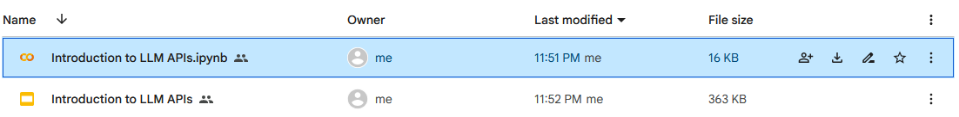
Instructions
Open Google Drive Link: https://tinyurl.com/IntroToLLMAPI
Click on “Intro to LLM APIs.ipynb”
To access our Workshops on GitHub:
https://tinyurl.com/UCLAStatsWorkshops

Slide 5

Google Colab Basics
Web-based cloud platform allowing people to executing Python code in a Jupyter Notebook environment
Python code divided into cells
Ctrl + Enter: run current cell
Ctrl + M + A: insert cell above
Ctrl + M + B: insert cell below
Ctrl + M + D: delete current cell
Ctrl + M + Z: undo
Mac Users: Cmd instead of Ctrl

Slide 6

Large Language Models
Large language models are massive language-based models (several million to several billion parameters) which are trained on large amounts of text data to process, understand and generate human language.

Slide 7
Application Programming Interface
Application programming interfaces (APIs) are what enable different softwares to communicate or transfer data from one to the other.
Data from software 1
API
Software 2

Slide 8

LLM API
Extending off the idea that an API essentially connects two softwares in and allows one to transfer data to another, an LLM API is specifically for allowing developers to access or utilize aspects of LLMS in their own applications.

Slide 9
Open this website: https://tinyurl.com/GGLAPIS25
Click the following button: Get a Gemini API key in Google AI Studio
Click on the following button: Create API Key
Copy & paste the following API key onto your notebook
Getting your
API Key

Slide 10
Prompts
Prompts are what users input in order to get an output from a model. For instance asking Chat GPT “What is the definition of prompts?” would be an example of a prompt.
The limitations of LLMs and general awareness of their design can help with figuring out useful ways to ask prompts to get desirable results
The idea of manipulating prompts motivates the field of prompt engineering

Slide 11
Adjusting configurations
Max output tokens: sets strict limit on length of output
Temperature: changes diversity of model output by smoothing out distribution
Top-p/k sampling: changes diversity of model output by increasing number of choices considered for output tokens
Top p versus k: top p restricts choices by cumulative probability of top token options summing up to probability p, top k would be by top k number of token options

Slide 12
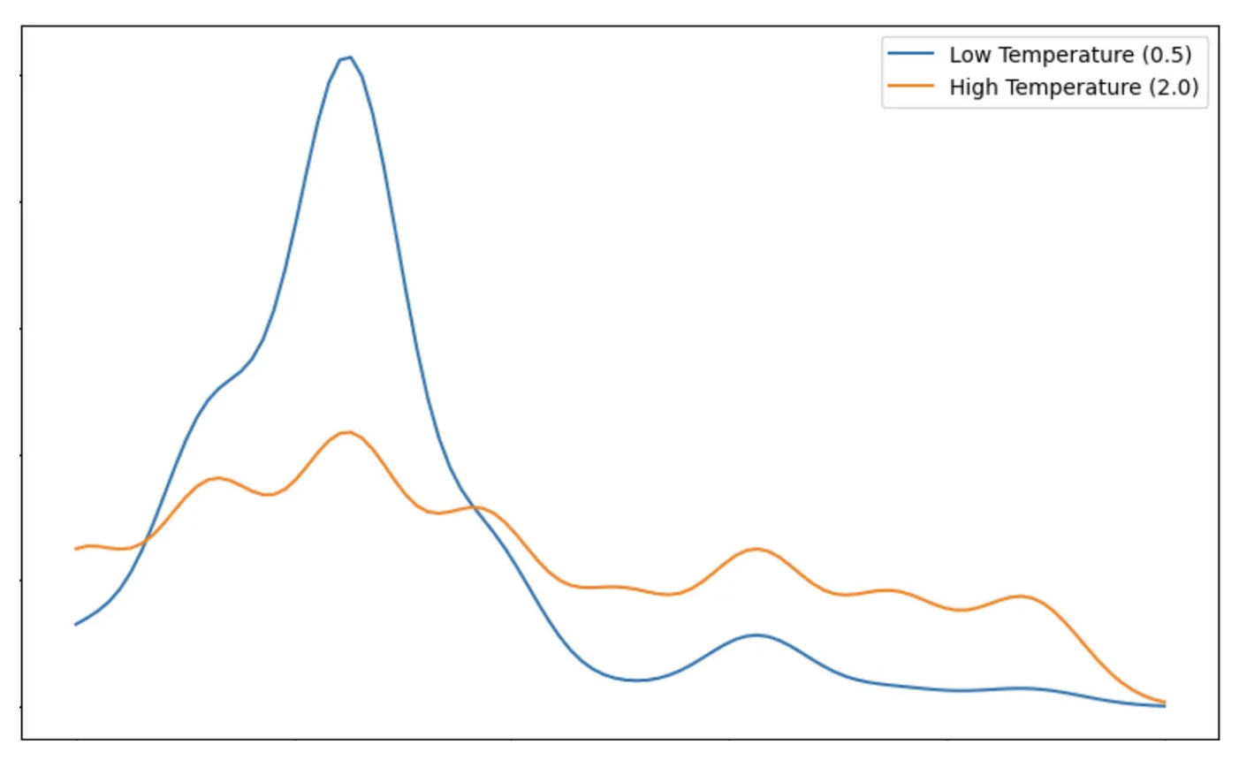
Temperature Distributions
Lower temperature is lower diversity
(between 0 and 1)
Higher temperature is higher diversity
(above 1)

Slide 13
Top p/k Examples
What I want most for Christmas is a _________.
Suppose below are the top 5 token probabilities for the continuation of the sentence:
Toy: 0.5
Car: 0.2
Doll: 0.1
Cat: 0.05
Dog: 0.04
. . .
Top p examples:
If p is set to 0.7, only choices for next output token are toy, car
If p is set to 0.85, only choices for next output token are toy, car, doll, cat
Top k examples:
If k is set to 3, only choices for next output token are toy, car, doll
If k is set to 5, only choices are toy, car, doll, cat, dog

Slide 14
Zero & Few-Shot Prompting
Due to the large scale of data the LLMs have trained on, they are able to achieve many tasks, such as in-context learning and zero-shot prompting.
Zero-shot prompting is when we ask LLMs to achieve some tasks without prior examples.
The performance can be improved if we give examples of the task and its corresponding answers into the prompt, allowing it to reference previous examples when generating its prompt.

Slide 15
Zero-Shot Sentiment Example
From a training perspective, we know the model has been trained on a lot of text data, so it has the ability to see patterns in words and classify then as “positive”, “negative”, or “neutral”
The main issue would be guiding the LLM to “know” that it should be using its capability of assigning these words, which is successfully done when using the prompt given in the Google Colab
Where challenges arise is if you do not know how to articulate what you want as the goal for some arbitrary task. In this case Few-Shot Prompting can be useful

Slide 16
Few-Shot JSON Example
In the pizza example, we see that there is a specific structure we want in the JSON file, but it would be long and hard to precisely explain in a typical paragraph input format
Rather than giving a complex paragraph input, in this case it can be easier to give examples of how you will input a pizza order and what you expect the output to be, then ask your new example without an answer

Slide 17
Few-Shot Visual
Input 1 given by you | Structure you want for Output 1 given by you
Input 2 given by you | Structure you want for Output 2 given by you
Input 3 given by you | Structure you want for Output 3 given by you
Input 4 given by you (From here we want model to give output) | Output 4 is from the model

Slide 18
Chain-of-Thought (CoT) Prompting
Prompting strategy to elicit a response that uses logical deductions in a systematic manner similar to human reasoning
Here is a simple math example showing what a chain-of-thought response would look like: Solve x^2 - 3x + 2 = 0 without using the quadratic formula, show your results step by step Goal response structure: Here’s how to solve the equation:
Factor the polynomial to get (x - 2)(x - 1)
Set each factor to equal zero to get x - 2 = 0, x - 1 = 0
Solve these simpler equations to get x = 2 and x = 1

Slide 19
Chain-of-Thought (CoT) Prompting
So how could we get a response that provides this kind of chained step reasoning?
One way is to simply ask for a step by step response, which we’ll see in the Google Colab
Notice how different the response was when adding “Return answer directly” versus “Let’s think step-by-step”

Slide 20
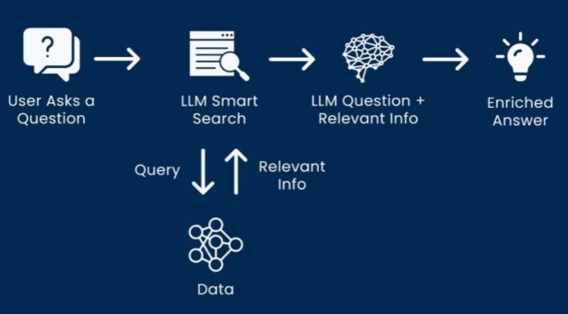
Retrieval Augmented Generation
Retrieval augmented generation (RAG) is a way to input data into LLMs to assist with their generation. Such data can include relevant documents to a given query.

Slide 21
Credits
Google & Kaggle for providing the code for this tutorial

